Slide 1
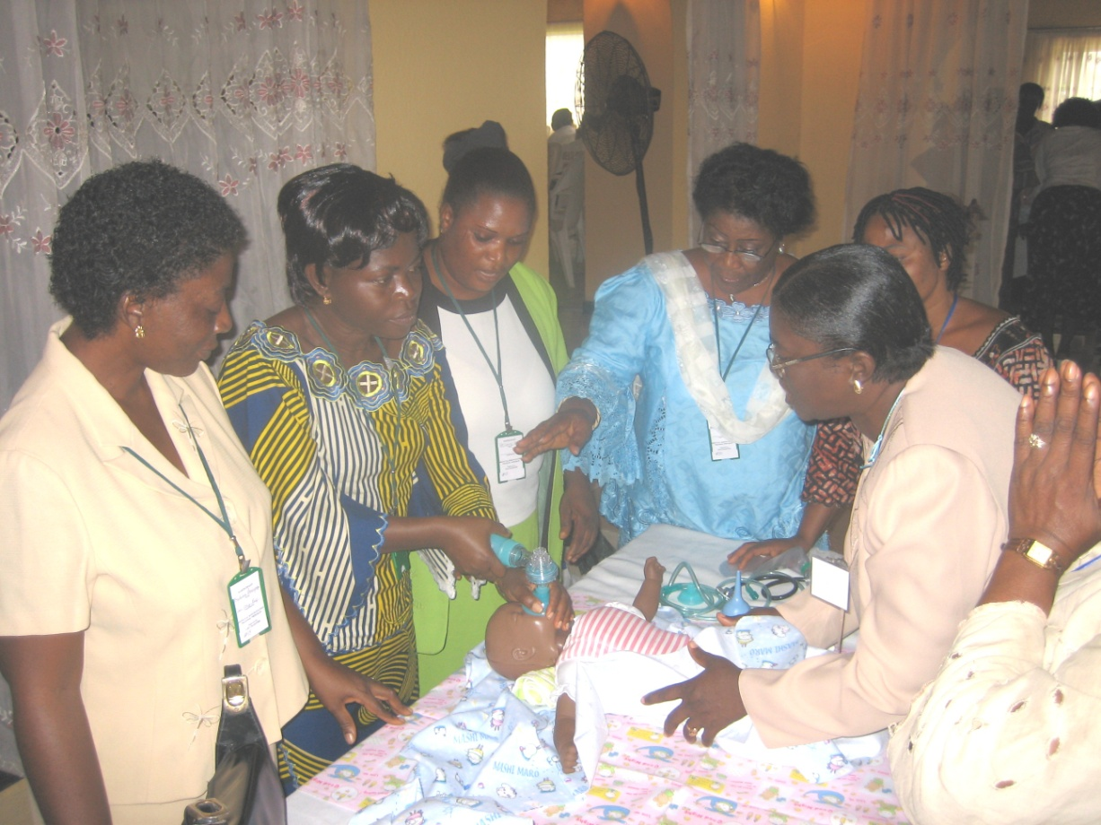
Neonatal Resuscitation
1

Slide 2
Overview and
Principles of Resuscitation
Content:
Resuscitation risk factors
Physiologic changes at birth
  Normal transition
  Abnormal transition
Premature infants at higher risk
How to prepare for resuscitation
2

Slide 3
Basic Steps in Resuscitation
Always
needed
Assess baby’s response at birth
100%
Dry, warm, clear airway, and stimulate
Needed less
frequently
Ventilation with
bag and mask
10%
Chest
compressions
Rarely Needed
1%
Meds
3

Slide 4
ABC’s of Resuscitation
  Airway
  Position and clear
  Breathing
  Stimulate to breathe
  Circulation
  Assess heart rate
4

Slide 5
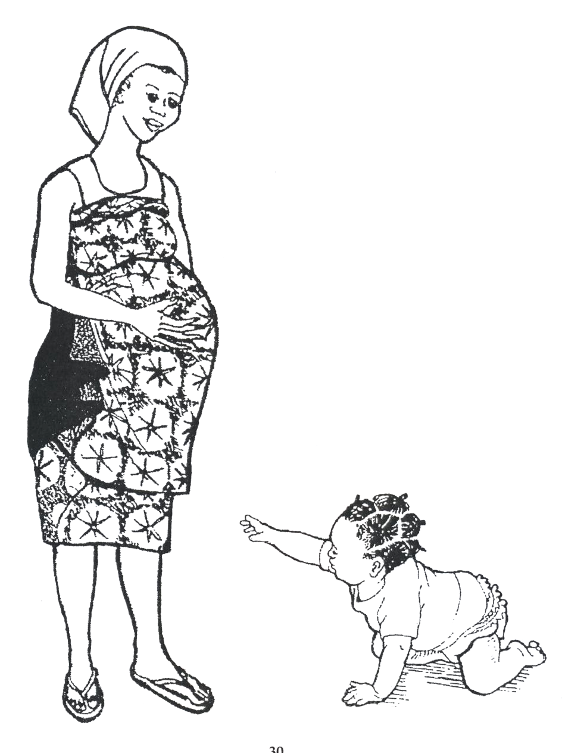
5

Slide 6
Risk Factors Associated with the Need for Resuscitation
Maternal Risk Factors Before Birth:
  Ruptured membranes over 18 hours
  Pre-eclampsia and eclampsia
  Maternal infection – malaria, HIV, etc.
  Premature labor
  Multiple births
  Others
6

Slide 7
Risk Factors Associated with the Need for Resuscitation
Risk Factors During Labor:
  Excessive bleeding
  Breech presentation
  Meconium
  Abnormal fetal heart tones
  Prolapsed or nuchal cord
  Rapid, hard labor
  Foul smelling fluid
  Prolonged labor
  Shoulder dystocia
7

Slide 8
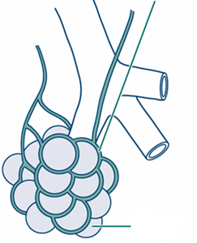
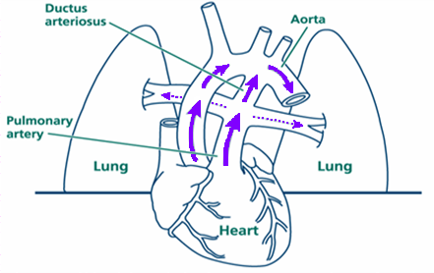
Blood Flow Before Delivery
Blood vessels are constricted
Blood flow in the lungs is decreased
Blood flow is diverted across the ductus arteriosus
Fluid in air sacs
Right atrium
Left ventricle
Right ventricle
8

Slide 9
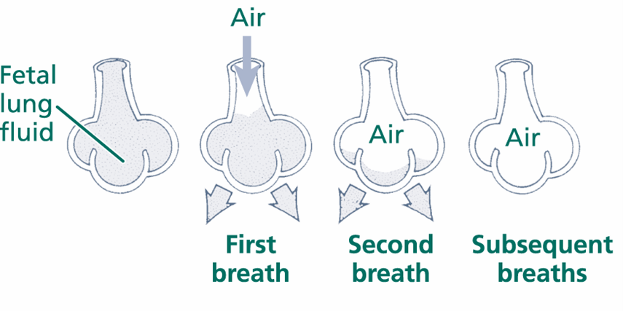
Blood Flow Changes at Birth
Lungs expand with air
Fetal lung fluid leaves air sacs
Fluid replaced by air in air sacs
9

Slide 10
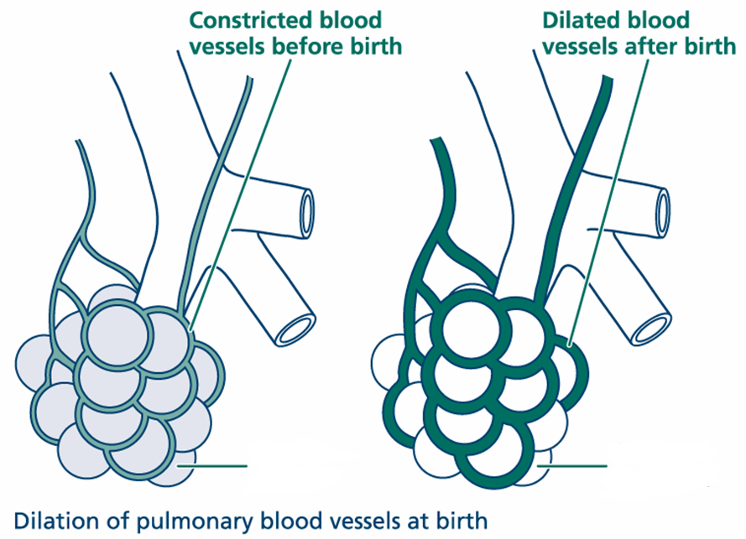
Blood Flow Changes at Birth
Umbilical cord clamped
Blood flow in the lungs increases
Blood vessels in the lung tissue relax
Fluid in air sacs
Oxygen in air sacs
10

Slide 11
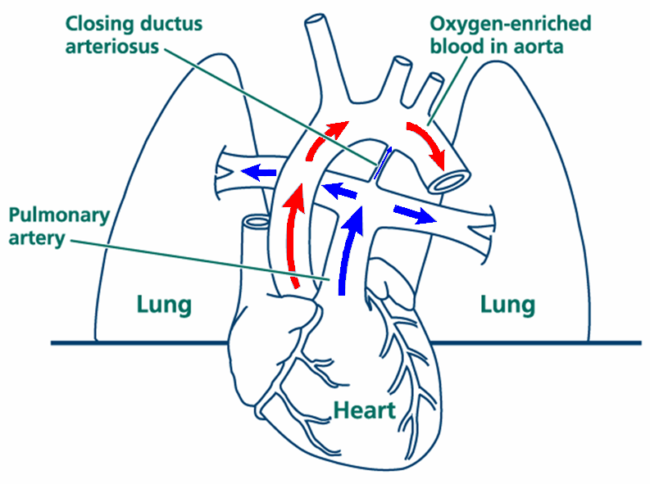
Blood Flow Changes at Birth
Blood oxygen levels rise
Ductus arteriosus begins to close
Blood flows through lungs to pick up oxygen
11

Slide 12
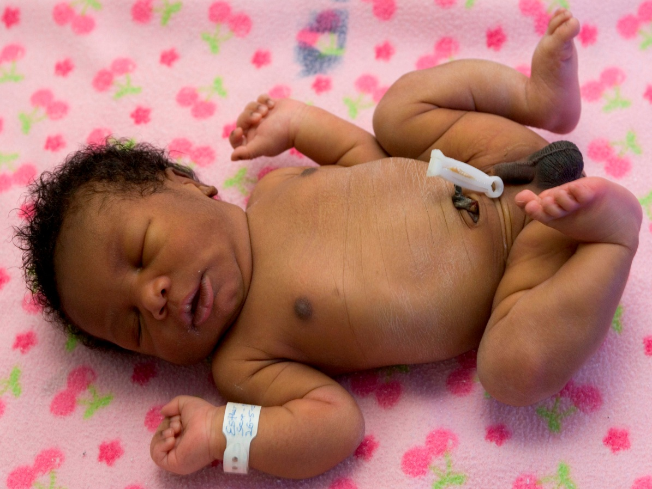
Normal Transition
No meconium
Breathing/crying
Good muscle tone
Term
12

Slide 13
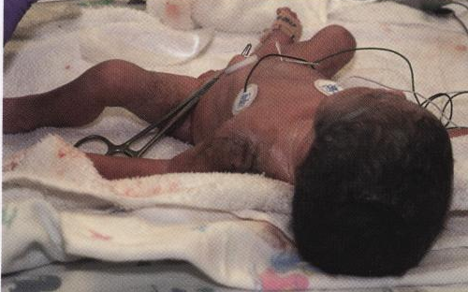
Abnormal Transition
Gasping, ineffective or no breathing
Poor muscle tone
Central cyanosis (blue)
All need assisted ventilation!
13

Slide 14
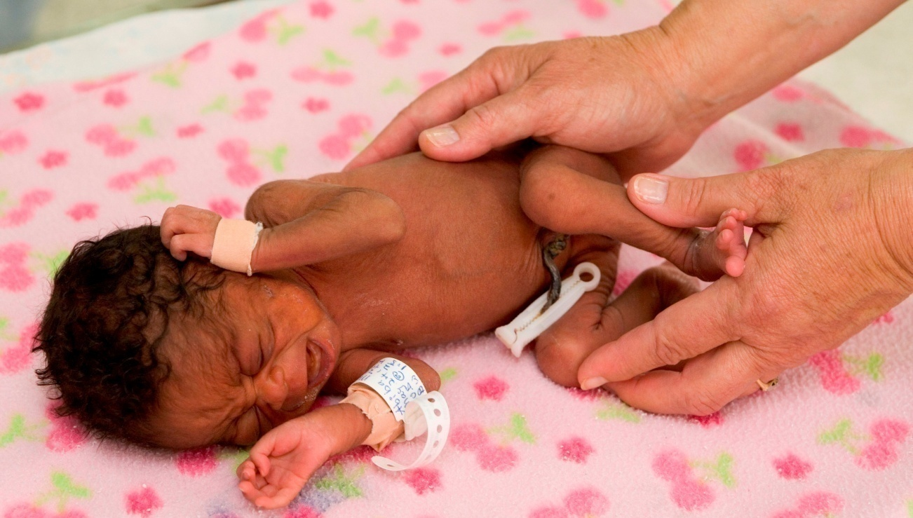
Premature Infants at
Higher Risk
Immature lungs – increased respiratory distress
Increased heat loss and poor temperature control
Possible infection
Prone to bleeding in the brain
Feeding problems
14

Slide 15
Prepare for a Delivery
Basic equipment:
  Heat source
  Blankets
  Suction
  Bag and mask
A person trained in neonatal resuscitation
15

Slide 16
At every delivery, there should be at least one person whose primary responsibility is the baby and who is capable of performing resuscitation.
16

Slide 17
Lesson 2
Initial Steps
The First 30 Seconds
Content:
Manage meconium if present
Provide warmth
Open the airway
Clear mouth and nose
Dry, stimulate, and reposition head
Evaluate
17

Slide 18
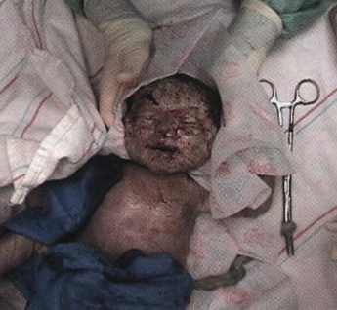
Meconium
18

Slide 19
Management of Meconium
Meconium
Initial Steps
Yes
Immediately
clear mouth
and nose
Continue with
initial steps
No
After delivery ask:
Is baby active
and breathing?
19

Slide 20
Provide Warmth
Place baby in warm location:
Warm surface, warm blankets
Away from draft
Heat lamp
Overhead warmer, if available
Skin to skin, if routine care
20

Slide 21
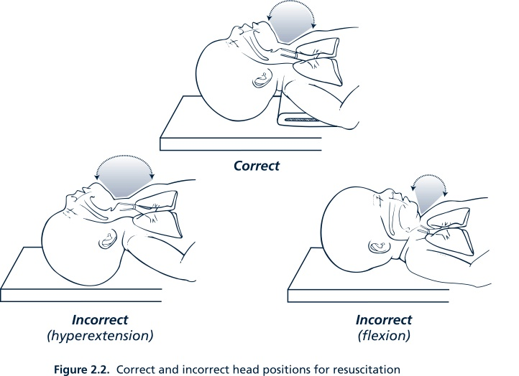
Positioning the Airway
Correct and incorrect head position for resuscitation
21

Slide 22
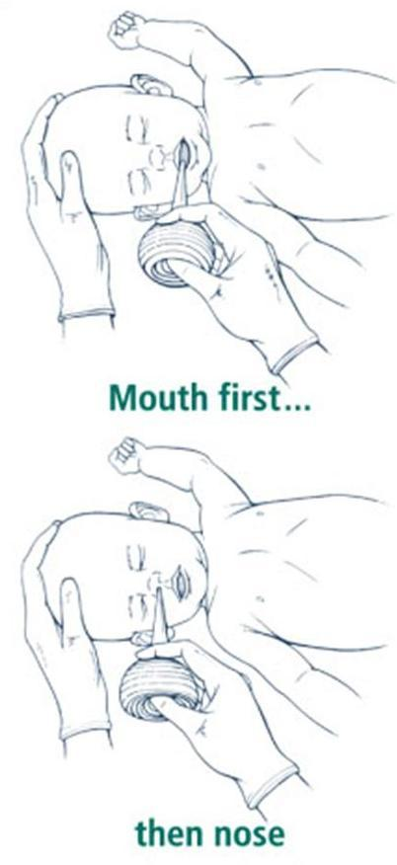
Clear the Mouth and Nose
Bulb syringe:
Suction mouth first, then nose
(“m” before “n”)
No bulb syringe:
Clear secretions with clean, dry cloth
No deep suctioning with bulb syringe or catheter!
Bradycardia (slowing of the heart rate) can result from deep suctioning
22

Slide 23
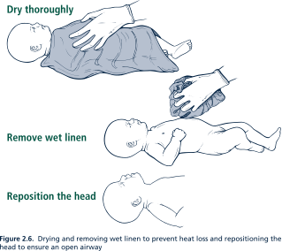
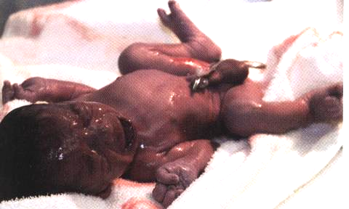
Drying the Infant
23

Slide 24
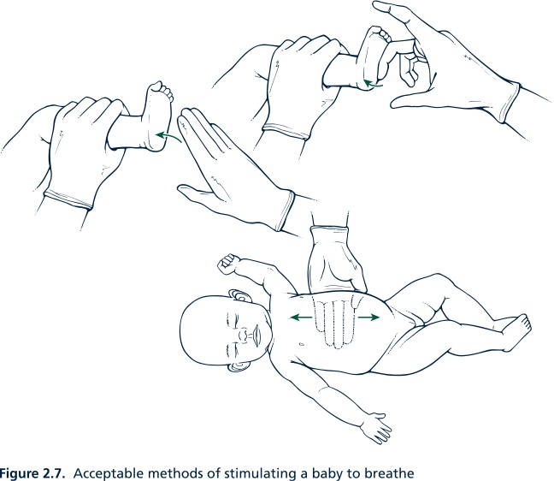
Tactile Stimulation
Acceptable ways to stimulate a baby to breathe
24

Slide 25
Do NOT Stimulate By:
Slapping the back
Squeezing the rib cage
Forcing thighs into the abdomen
Dilating anal sphincter
Hot or cold compresses or baths
Shaking
25

Slide 26

How to Prioritize Actions
Evaluation is based on:
Respirations (breathing/crying)
Heart rate
Color
26

Slide 27
Evaluate Respirations
YES
Unlabored breathing/crying
Listen with stethoscope
NO
If shallow breathing, gasping,
or not breathing at all, give
positive-pressure ventilation
27

Slide 28
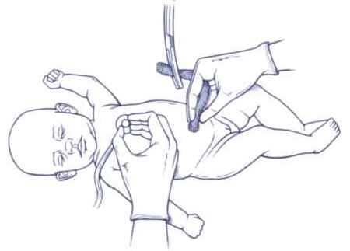
Evaluate Heart Rate
Feel pulse at base of umbilical cord or listen with stethoscope
Count for 6 seconds
and multiply by 10
Example:
If you counted 13 pulsations in 6 seconds the baby’s heart rate would be
13 x 10 = 130
Heart rate <100 requires positive-pressure ventilation
28

Slide 29
Evaluate Color
Peripheral cyanosis (a bluish color):
  Pink centrally: assess lips and gums
  Bluish color of hands and feet
  Requires no further action
Central cyanosis:
  Bluish color of the trunk and limbs
  Bluish color of lips and gums
  Use free-flow oxygen, if available, or positive-pressure ventilation
29

Slide 30
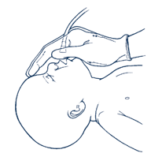
Free-flow Oxygen
If the infant is breathing but there is persistent central cyanosis, give
free-flow oxygen.
Flow rate at approximately 5-10 L/min
If not available, use positive-pressure (bag and mask) ventilation
30

Slide 31
Newborn Resuscitation Flowchart Initial Steps
Clear meconium,
if present
Provide warmth
Position; clear airway
Dry and reposition
Stimulate if necessary
30 seconds
Is the baby breathing?
What is the heart rate?
What is the color?
31

Slide 32
If the Evaluation is NOT Normal
Is the baby breathing?
What is the heart rate?
What is the color?
30 seconds
Not breathing, or
Heart rate <100, or
Poor color
Reevaluate after 30 sec.
Provide positive-pressure ventilation
Check for increasing heart rate
Correct problems
Give oxygen if available
32

Slide 33
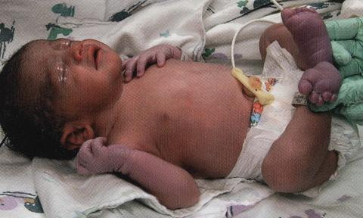
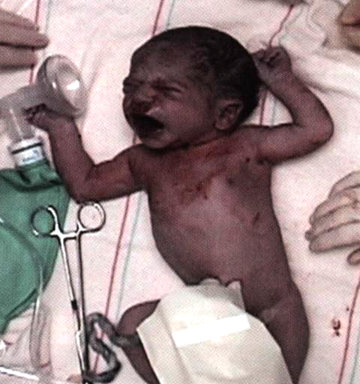
Evaluate These Newborns
33

Slide 34
Lesson 3
Positive-Pressure Ventilation
The Second 30 Seconds
Content:
  When to ventilate
  Self-inflating bag and mask
  Important characteristics of face mask
  Testing bag and mask
  Preparing for positive-pressure ventilation
  What if the baby does not improve
34

Slide 35
Ventilation
Ventilation of the lungs is the single most important and effective step of resuscitation.
35

Slide 36
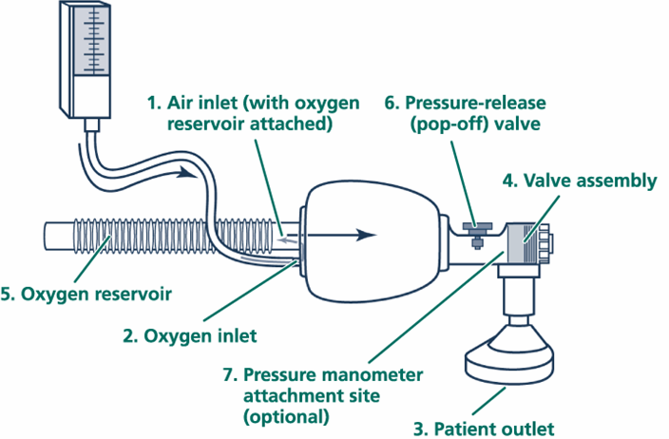
Basic Parts of Bag and Mask
90-100% O to infant
2
37

Slide 37
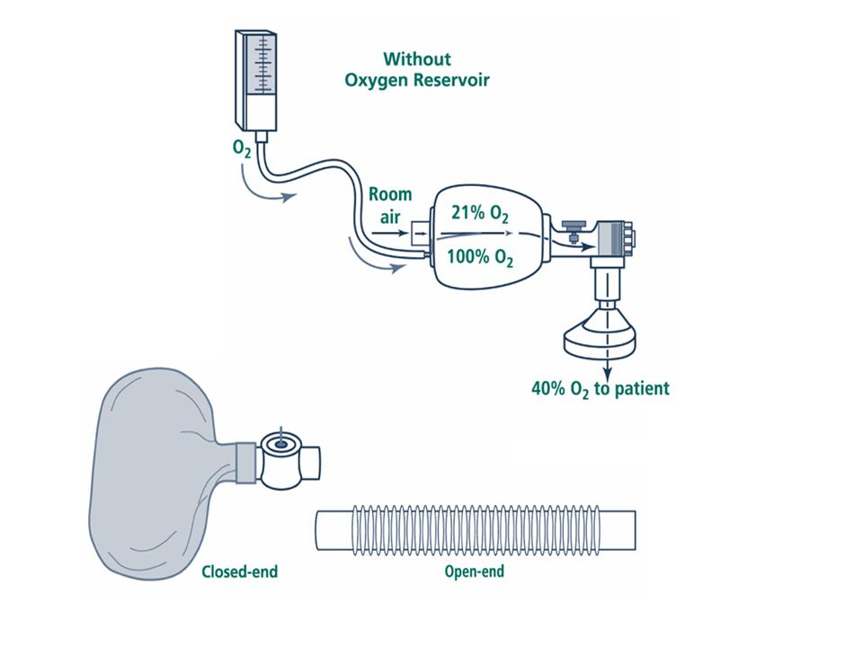
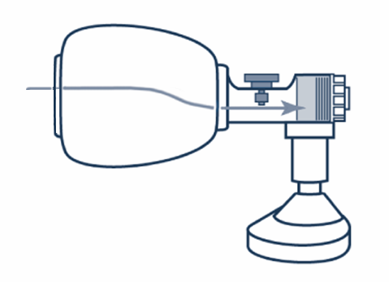
Room Air May Be Used for Resuscitation
Room air to infant
40% O2 to infant
38

Slide 38
Operation of Bag and Mask
Pressure determined by 3 factors:
How hard the bag is squeezed
Any leaks between mask and face
Set point of pressure-release (pop-off) valve
39

Slide 39
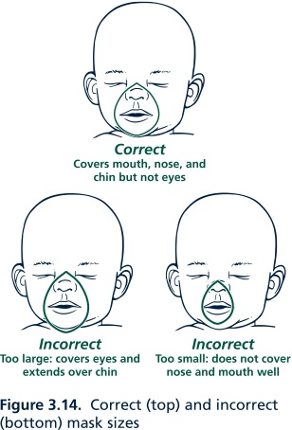
Face Mask Size
Correct: Covers mouth, nose, and chin
Incorrect:
Too large - covers eyes and extends over chin
Too small - does not cover nose and mouth
40

Slide 40
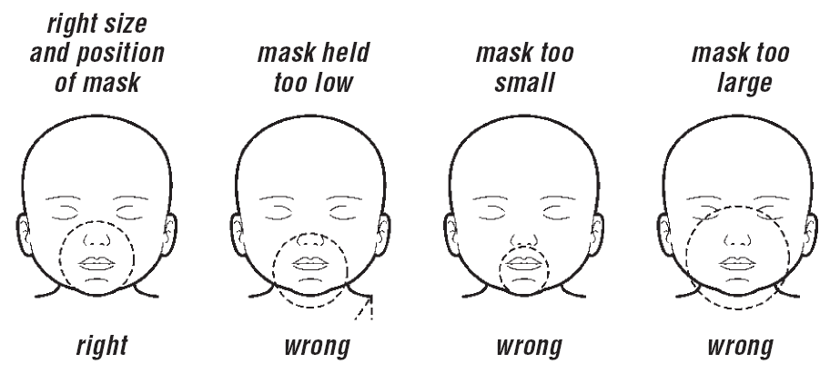
Resuscitation – Step 3 - Breathing
Notes:
These are examples of how to size and fit a mask – soft round masks are often the easiest to use.
From left to right
Shows a correct mask fit
The mask goes over the chi and presses on the nose
Only the mouth is covered
The mask goes over the chin and presses on the eyes.

Slide 41
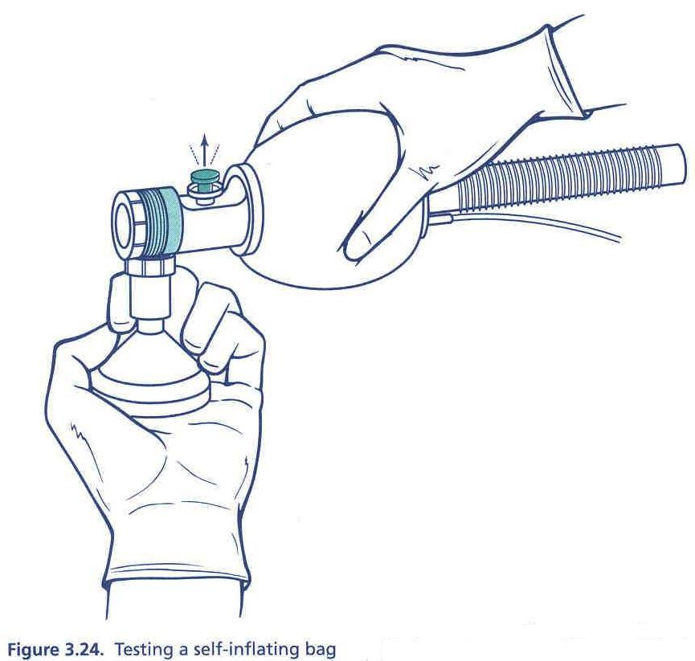
Testing Bag and Mask
Pressure against your hand?
Pressure-release valve opens?
41

Slide 42
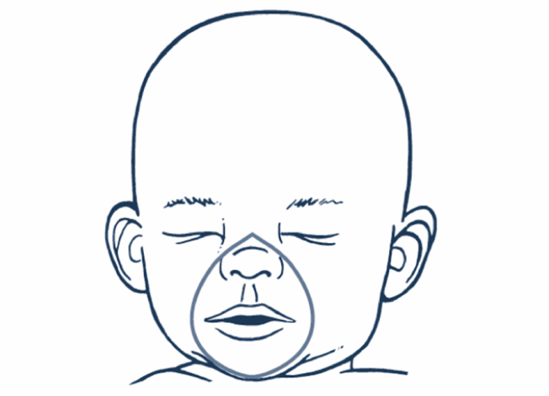
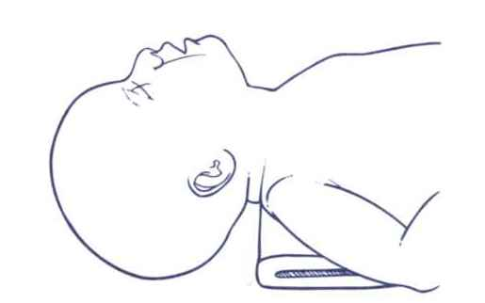
Face Mask Placement
Correct positioning: cover mouth, nose, and tip of chin, but not the eyes
Correct position for assisted ventilation
42

Slide 43
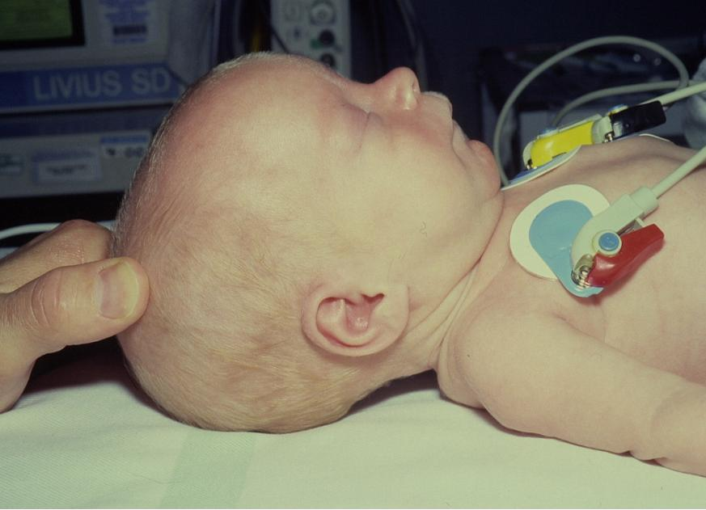
Airway opening (1)
Notes:
In the slide a normal term baby is lying on a flat surface.
Because the back of a baby’s head is large the natural position for a baby placed on such a hard surface is with the head flexed (tilted forwards with the chin on the chest).
This flexed position is a very good way of closing the airway.

Slide 44
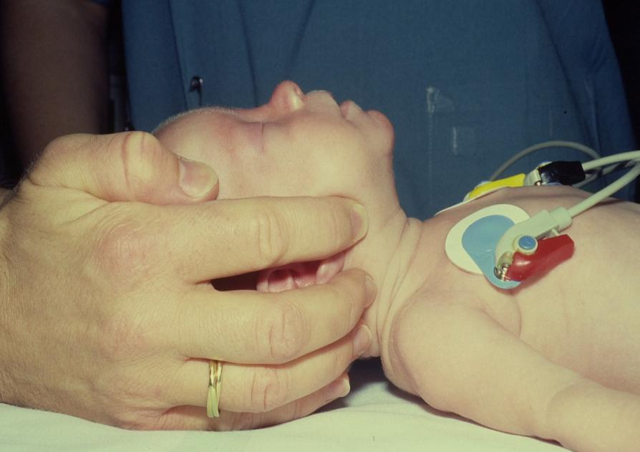
Airway opening (2)
Notes:
To open the airway we must do something about the position – moving it into what is called the ‘neutral position’ with the nostrils and lips making a line that is parallel to the line of the surface the baby is lying on.
In the picture the position is being achieved by lifting the jaw from the angle of the mandible and extending the neck a little (the jaw thrust). In most cases the head-tilt / chin lift approach is used (this is harder to show in a photo). Do not hyper-extend the neck so the jaw points to the ceiling – in babies this also blocks the airway.

Slide 45
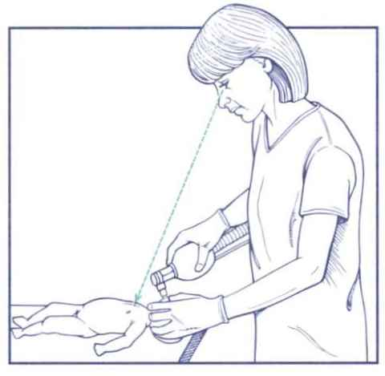
Preparing for Positive-Pressure Ventilation
Select correct-sized mask
Clear airway
Position head
Position yourself at side or head of baby
43

Slide 46
Effective Use of Bag
The primary sign of good ventilation is an increase in heart rate
Apply enough pressure to create noticeable, gentle rise and fall of the chest
Bilateral breath sounds
Improvement of color and heart rate
Initial breaths may require higher pressures
If baby appears to be taking a very deep breath, too much pressure is being used
44

Slide 47
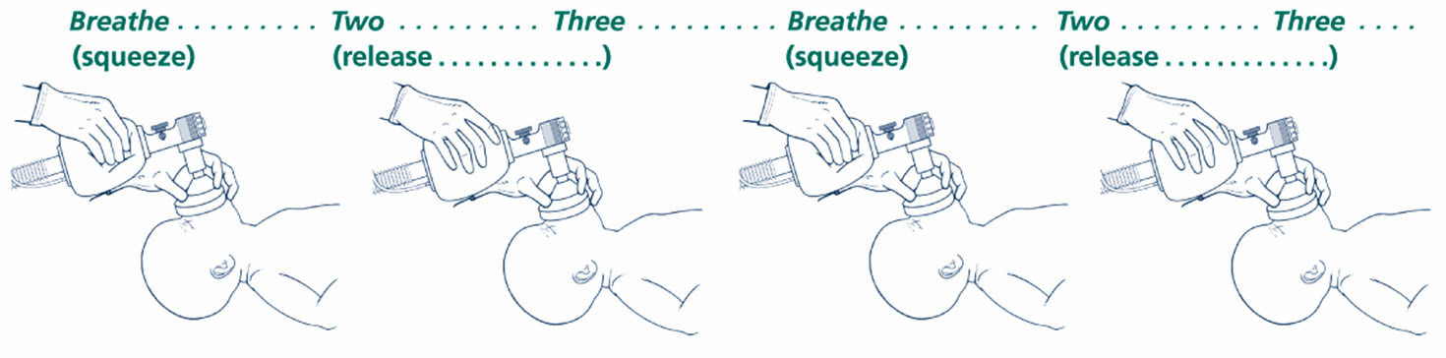
How Often Should You
Squeeze the Bag?
40-60 breaths per minute
Count out loud: “Breathe—two—three”
45

Slide 48
Signs of Improvement
Increasing heart rate (>100)
2. Improving color
Spontaneous breathing or crying
Improving muscle tone
46

Slide 49
Inadequate Chest Expansion
PROBLEM
Inadequate seal
Blocked airway
Not enough pressure
Equipment malfunction
ACTION
Reapply mask to face, check size, remove vernix
Reposition head
Check for secretions and suction if present
Ventilate with newborn’s mouth slightly open
Increase pressure until there is an easy rise and fall of the chest
Fix or use backup equipment
47

Slide 50
Is Adequate Oxygen Being Administered?
If available, is 100% oxygen being given?
Oxygen tubing attached to the bag and the oxygen source?
Gas turned on?
Oxygen reservoir attached?
Oxygen in the tank?
If supplemental oxygen is not available, give
positive-pressure ventilation using room air!
48

Slide 51
– Be Prepared!
Note for all newborns:
  Practice delayed cord clamping to prevent early infant anaemia
  Clean the cord with 7.1% Chlorhexidine Digluconate (4% Chlorhexidine) once baby stable and then daily until the cord separates
  Ensure HIV risk known and give TEO & Vitamin K

Slide 52
Prepare BEFORE delivery – Equipment, Warmth, Getting Help
If the baby has not taken a breath at all think - Is there MECONIUM?
No
Yes
Use warm cloth: dry and stimulate, observe activity, colour and breathing, wrap in new, warm cloth with chest exposed
Before first breath and before drying / stimulating – Suck / clean oro-pharynx under direct vision. Do not do deep, blind suction
Breathing should be started within 60 secs
Baby now active & taking breaths?
Yes
Skin to skin with mother to keep warm and observe – initiate breast feeding
No
Check airway clear – if anything visible use suction to clear
Put head in neutral position
A
Keep Warm, Count rate of breathing and heart rate – give oxygen if continued respiratory distress
B
Is baby breathing?
Yes
Poor or No Breathing / Gasping - Call for Help!
ABC OK
B
Start ventilation Ensure the chest rises in first breaths – continue at about 30 breaths / min.
Check heart rate at 1 min
Continue with about 30 breaths / min,
Reassess ABC every 1-2 minutes, stop using bag when breathing and heart rate OK
Yes
Give 1 EFFECTIVE breath for every 3 chest compressions for 1 min, Reassess ABC every 1-2 minutes, stop compressions when HR >60 bpm and support breathing until OK
C
Is the heart rate > 60bpm?
No

Slide 53
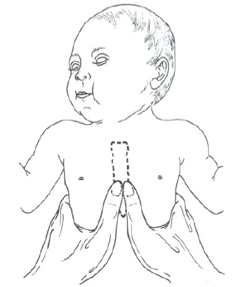
Resuscitation – Step 4 - Circulation
Compress over sternum
1 finger-breadth below nipple line
Two fingers if solo resuscitation
Thumbs if 2 or more people
1/3rd the depth of the chest
Notes:
If there are two people then the ‘two-thumbs’ approach can be used. If you are alone then you put two fingers on the lower sternum 1 finger breadth below the line connecting the nipples.
The aim is to compress the chest to about 1/3rd its depth – the sternum should move about 1.5cm downwards when you press.
Press and release – the real effect of compressions is to move blood into the lungs and then into the coronary arteries – like a siphon pump. You are really not pumping blood around the body by compressing the heart.

Slide 54

Key to Success
Establishing effective ventilation is the key to nearly all successful neonatal resuscitations!
50

Slide 55
Cessation of resuscitation
It is appropriate to consider discontinuing after effective resuscitation efforts if:
• Infant is not breathing and heartbeat is not detectable beyond 10 minutes,stop Resuscitation.

Slide 56
If no spontaneous breathing and heart rate remains below 60/minute after 20 minutes of effective resuscitation, discontinue active resuscitation.
Record the event and explain to the mother or parents that the infant has died.
Give them the infant to hold if they so wish.

Slide 57
conclusion
One should always be ready for resuscitation
Most babies do not need resuscitation
Only 10%require Ventilation,1%compression and less than 1% drugs
airway and breathing very vital components of resuscitation

